Slide 1
XFT: Practical Fault Tolerance Beyond Crashes [2016]
COS 518: Advanced Computer Systems
James Heppenstall & Suriya Kodeswaran
April 17, 2019

Slide 2
Motivation
Trend: BFT is not widely adopted in industry to solve the SMR problem
Mainly due to additional cost in terms of resources, complexity, and performance
But Byzantine faults are common!
Malicious adversaries, faulty hardware, software bugs, human error, cosmic rays (according to the paper 😱), etc.

Slide 3
Previous Solutions
Crash Fault-Tolerance (CFT)
Paxos [1988]
Zab [2011]
Raft [2014]
Byzantine Fault-Tolerance (BFT)
PBFT [2002]
Zyzzyva [2009]
Chain/Aliph [2015]
Notes:
It is worth noting that all of the above solutions to the SMR problem assume an asynchronous network model, in which packets are not guaranteed to arrive within a specified time frame, and could be reordered or even dropped.

Slide 4
Key Idea
CFT is too optimistic while BFT is too pessimistic
So the paper introduces an intermediate system model
Cross Fault-Tolerance (XFT)
Clients and replicas can suffer Byzantine faults
All replicas share reliable bi-directional communication channels
An eventually synchronous network model

Slide 5
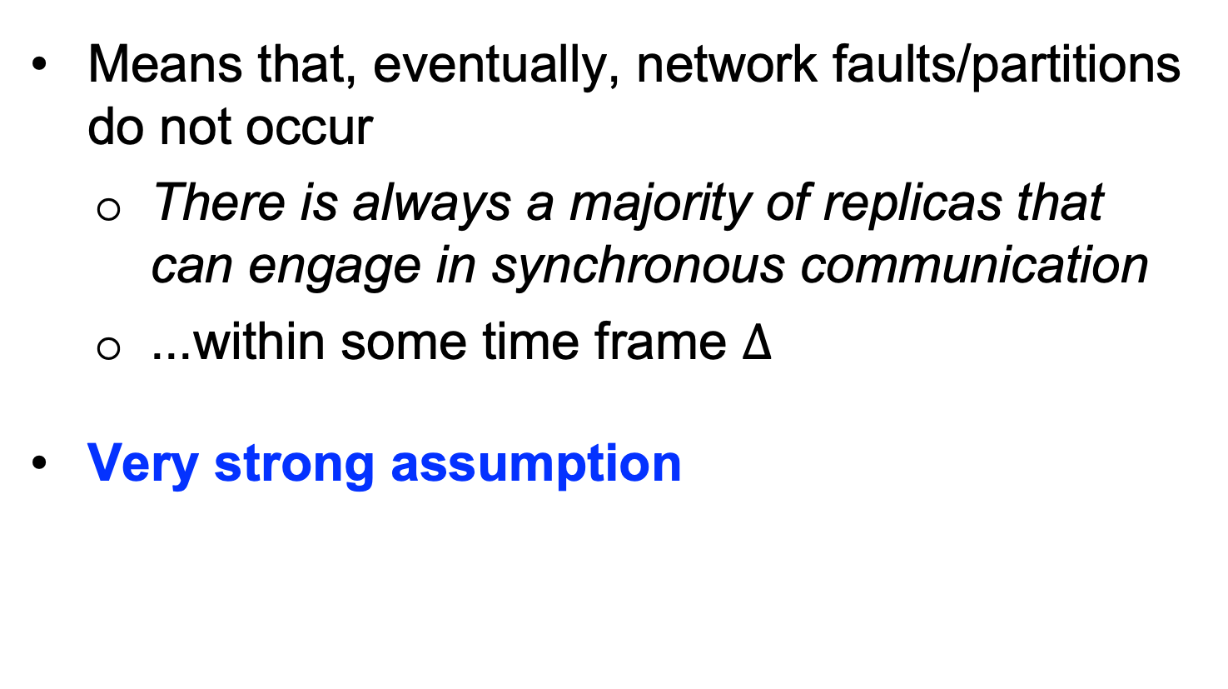
Eventually Synchronous Network Model
Means that, eventually, network faults/partitions do not occur
There is always a majority of replicas that can engage in synchronous communication
...within some time frame $Δ$
Very strong assumption

Slide 6
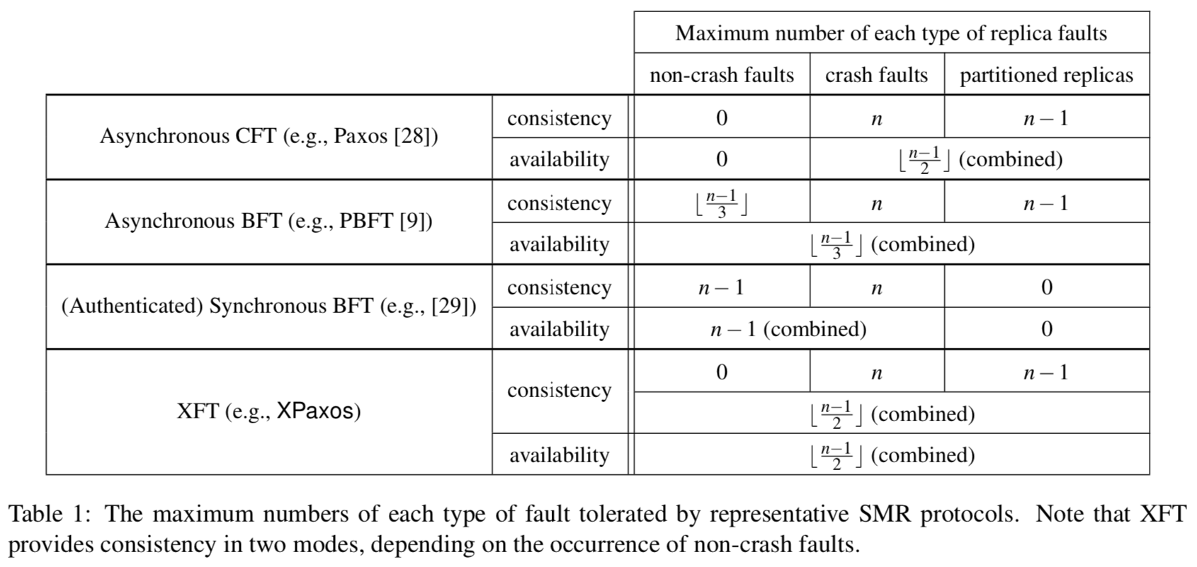
Comparison of SMR Protocols

Slide 7
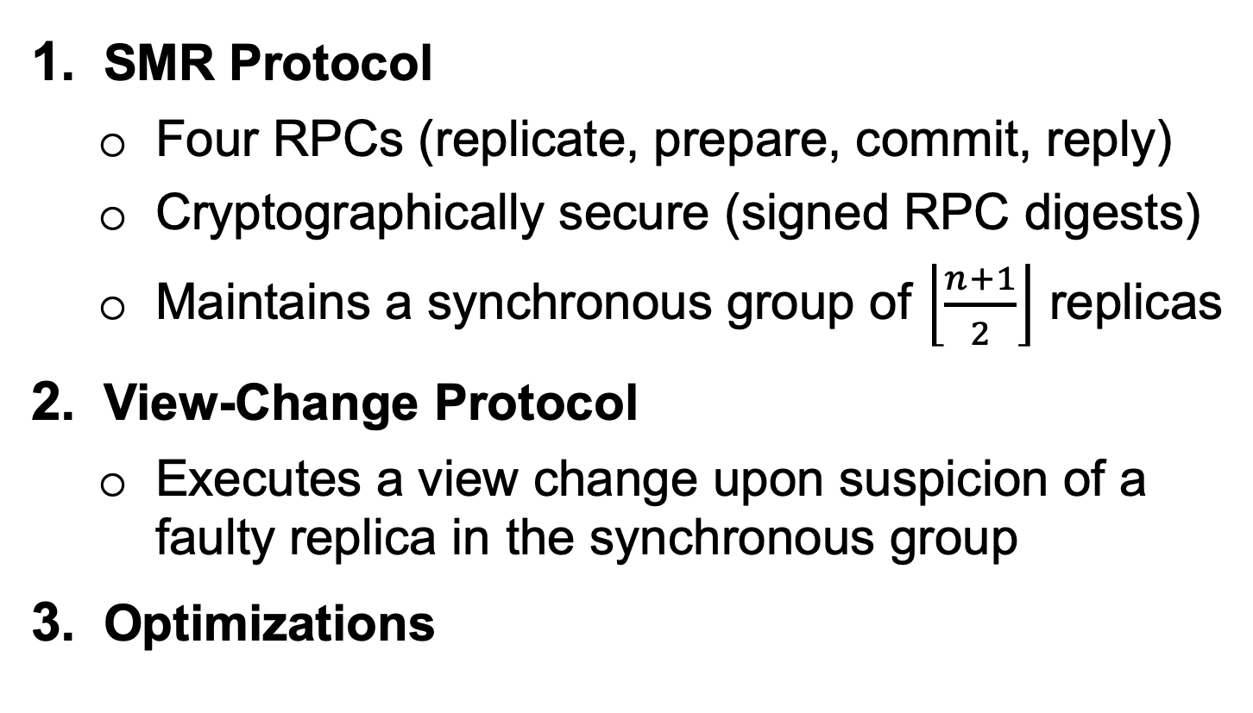
XPaxos System Architecture
SMR Protocol
Four RPCs (replicate, prepare, commit, reply)
Cryptographically secure (signed RPC digests)
Maintains a synchronous group of $\left\lfloor \frac{n+1}{2}\right\rfloor$ replicas
View-Change Protocol
Executes a view change upon suspicion of a faulty replica in the synchronous group
Optimizations
Notes:
XPaxos is the first implementation of XFT.
Optimizations:
Request Retransmission Protocol
Fault-Detection Protocol
Checkpointing, Lazy Replication, Batching/Pipelining

Slide 8
XPaxos System Architecture
Notes:
It is worth noting that XPaxos is optimized for the case where there are only 3 replicas (i.e. synchronous group consists of 2 replicas).

Slide 9
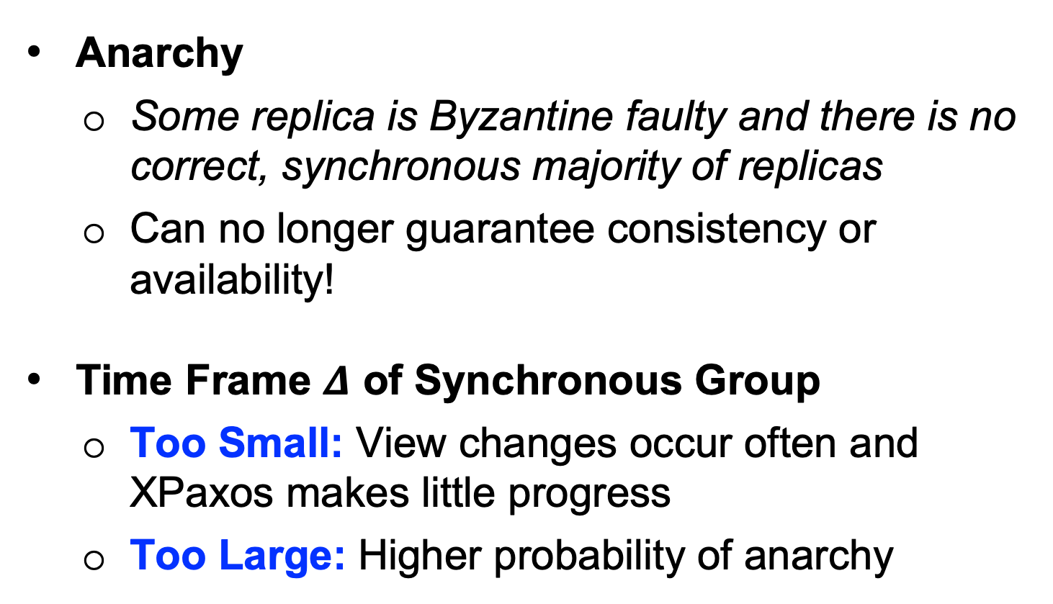
Key Challenges
Anarchy
Some replica is Byzantine faulty and there is no correct, synchronous majority of replicas
Can no longer guarantee consistency or availability!
Time Frame $Δ$ of Synchronous Group
Too Small: View changes occur often and XPaxos makes little progress
Too Large: Higher probability of anarchy

Slide 10
Implementation
Goal: Implement XPaxos from scratch in Go
Simulating a network of clients and replicas with the net/rpc package
Excluding optimizations unless time allows
We plan to evaluate XPaxos against unoptimized Go implementations of Paxos and PBFT
Key performance metrics include throughput vs. latency and scalability

Slide 11
Evaluation

